Slide 1

Multi-Agent Stock Market Simulation Project
Elias Huber
Ruben Parte Pombo
Diederik Jan Willem

Slide 2

Modeling Dynamic Stock Market Enviroments
Multiple investors engage in real-time transactions facilitated by a broker within a dynamic stock price environment.

Slide 3

Types of Agents:
As in a real-life stock market:
Investors have a portfolio and implement a certain strategy based on risk adversity, long-term vs. short-term goals and opinions/social influence.
Brokers serve as an intermediary, managing investor offers, matching trades, and updating on completed transactions in the simulated stock market.

Slide 4
Agent Behaviours, Decision-Making
Indicators (TA-lib)
Investor attributes (initialized randomly)
Relative Strength Index (RSI)
Stochastic Oscillator (%K and %D) with a moving average indicator (MA)
Bollinger Bands
Moving Average Convergence Divergence (MACD)
Time factor [0, 1]
Influenceability index [0, 1]
Risk factor [0, 1]
Investor’s own opinion about a stock [0, 1]
Popular opinion about a stock [0, 1]

Slide 5
Communication and Interaction Rules
Stock Market
Broker
Investor
Investor
Investor
Investor
Investor
Investor

Slide 6
Order Matching
Investors decide on buy/sell prices and corresponding quantities using a strategy and form new opinions.
Investor sends offers to broker
Broker matches orders by comparing offers and executes them by acting on the environment

Slide 7
Opinion and social influence
The value of the opinion and reputation of a stock, determines what proportion of this money the investor is going to spend on that stock.
If it is 1 for a stock, he only buys and sells this stock -> ability to diversify
Different investors use different strategies to form their opinions by comparing their cue values of the stock.

Slide 8
Representing Agents Performance

Slide 9
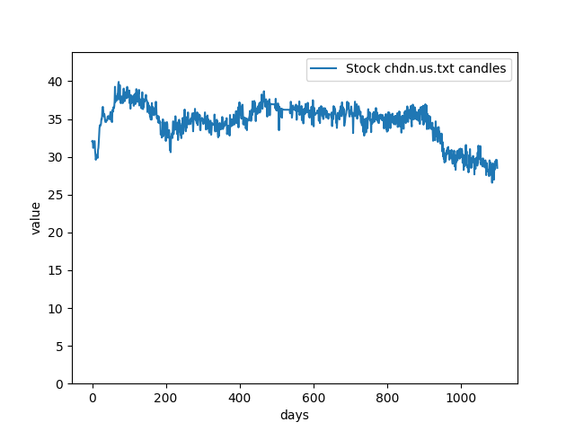
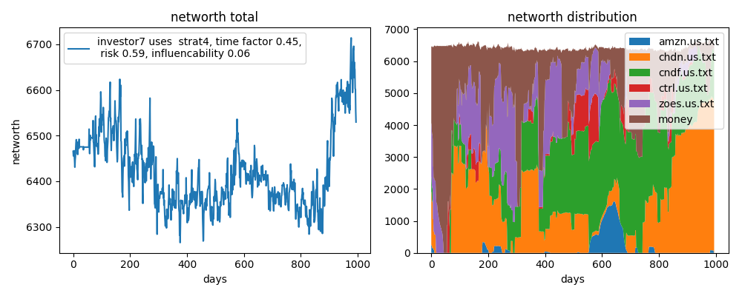
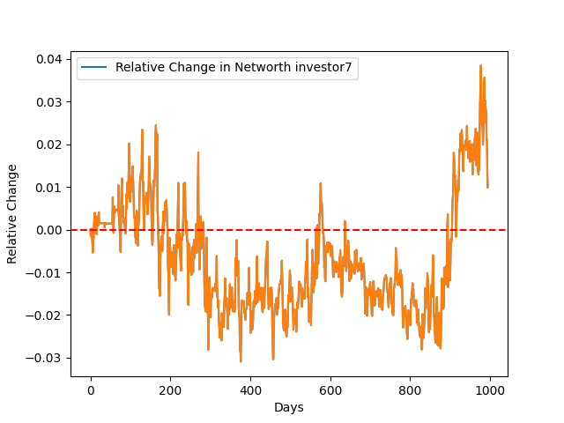
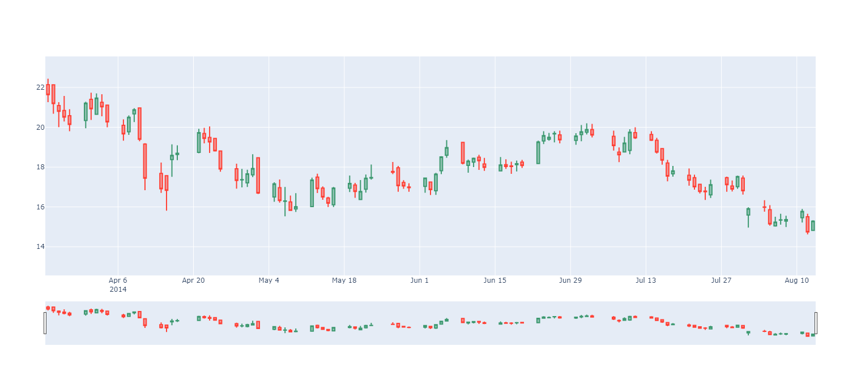
Visualizations & results (1000 iterations, 5 stocks, 10 investors)

Slide 10
Conclusions
Working complex agent-based stock market simulation.

Slide 11
README
Simulation procedure:
Put the stocks you want to simulate in the stock folder-> Simulation will automatically recognize and trade them.
Investors are created with certain money, stock ownership, risk factors, opinions, and social influenceability.
Investors form a social score accessible to everyone with their own opinions.
Investors use different strategies which observe the stock market, analyze the stock cues, social reputation and opinion to create stock offers and form new opinions
Investors send offers to broker, and he matches the matching offers
Broker acts on the stock market by putting the transactions as the new stock candles
Broker sends confirmation
repeat

Slide 12
Opinion and social influence
The value of the opinion and reputation of a stock, determines what proportion of this money the investor is going to spend on that stock.
If it is 1 for a stock, he only buys and sells this stock -> ability to diversify
different investors use different strategies to form their opinion whether, by comparing their cue values of the stock

Slide 13
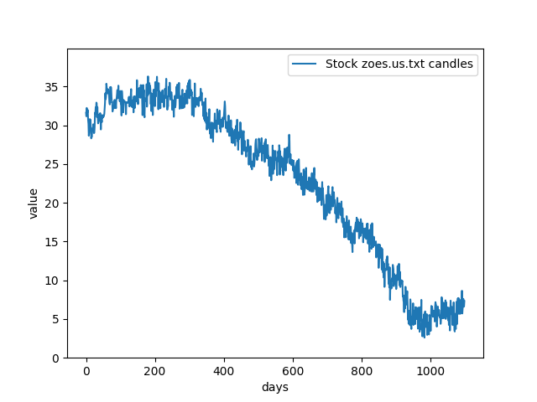
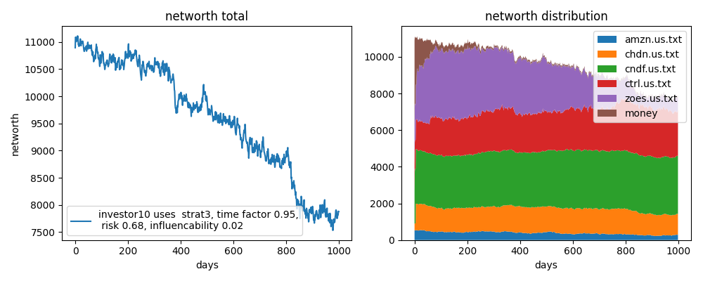
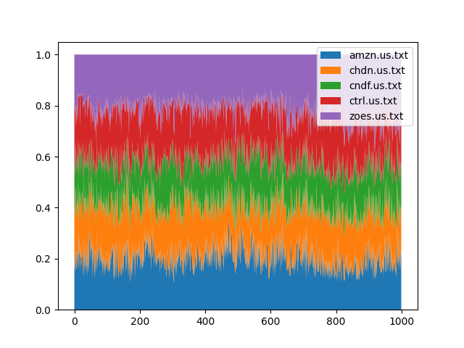
Some more plots from the same simulation as in slide 9
Here we can see that the ZOES stock plummeted which resulted in a big loss for investor 10
In the left corner we can see plot of the varying popularity of the stocks

